Slide 1
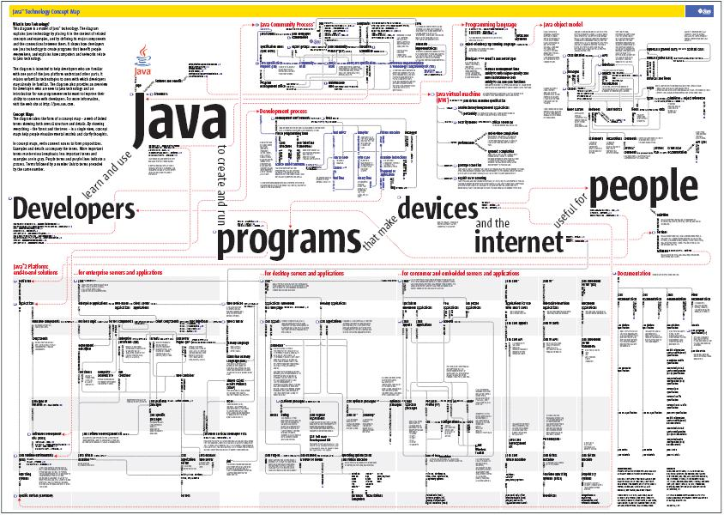

Slide 2
Introduction to JAVA
Welcome

Slide 3
Module Objectives
All you need to know and never forget about Java.
Why Java?
Java architecture.
How Java program work?
Java “bytecode”
Java Virtual Machine (JVM)
What exactly do you have to learn in Java?
Java programming language
Java class library (APIs)
How to create, compile and run a Java program?
J2SE, JDK tools
JRE.
Your first Java program.

Slide 4
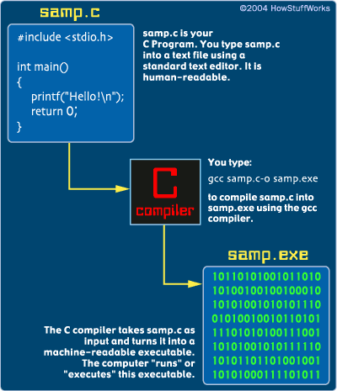
Programming Review
Computer programming.
Programming language.
Compiler.

Slide 5
and there is a problem…
In a typical C program, the source code is compiled into a native machine language module that consists of 1’s and 0’s.
The machine language is specifically to specify Operating System ( Windows, Mac, UNIX or Linux…)
Is it impossible for one object module to be portable between platforms?
Obviously, No.

Slide 6
Do you know, use or build:
Console application?
Web application?
Desktop application?
Mobile application?

Slide 7
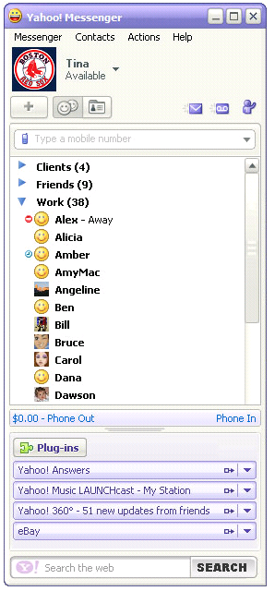
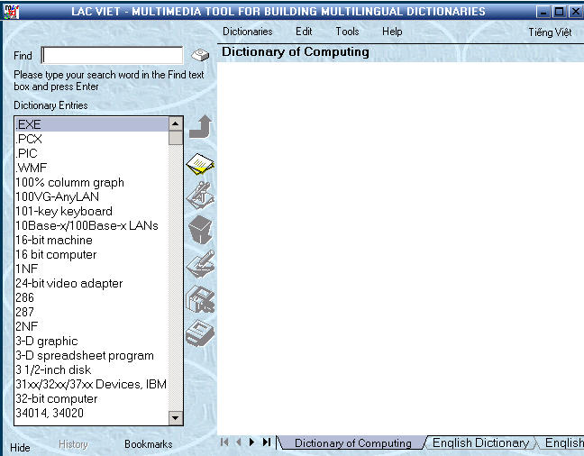
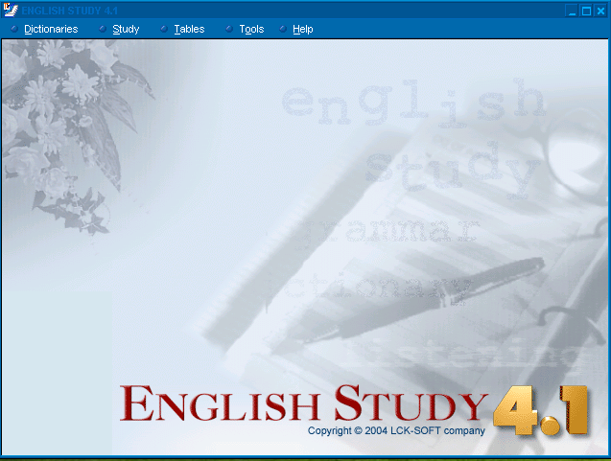
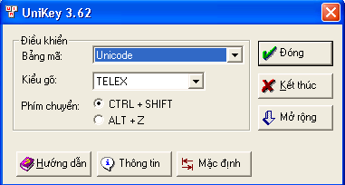
Desktop Application
What is Desktop Application and How to create?

Slide 8
Microsoft Solutions for Development Desktop Application
Tools:
Visual Studio.
Programming language:
Visual Basic (VB), Visual C++, C#.
Runtime environment
Windows Only.

Slide 9
How to build Desktop Application using Microsoft solutions?
Build
Package
Setup
Run
Easy, quick and cheap...
For fixing bug or updating, customers only need service pack.

Slide 10
but there is a problem..
It’s a question “how it works?”
The answer is: “based on DLL technology”
Dynamic Link Library (DLL)
A library that contains code and data that can be used by more than one program at the same time.
It only works with Windows OS
with suitable version or service pack
You don’t know what it do with your system.
It may be doesn’t not work if:
Customers change or update Windows OS
or install other application (“DLL hell”)
……

Slide 11
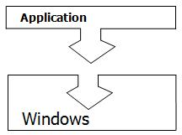
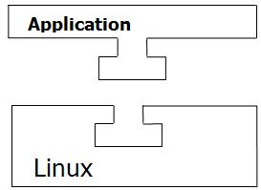
If customers using other OS than Windows...
Does your application work?
No!
Your solutions?

Slide 12


Sun Microsystems Solutions Oracle acquired Sun Microsystems in 2010
welcome

Slide 13

JAVA, Solution of Sun Microsystems
Father of Java
PhD. James Gosling
CTO of Sun's Developer Products.

Slide 14
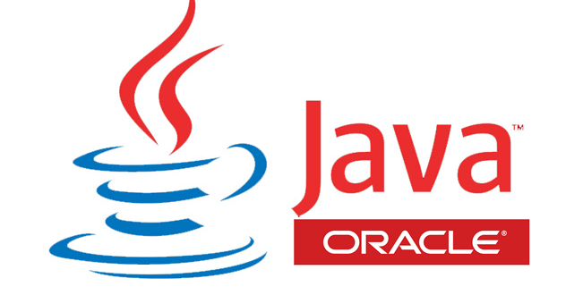
What is Java?
Sun's trademark for a set of technologies for creating and safely running software programs in both stand-alone and networked environments.

Slide 15
Java architecture
Java Programming Language
Java class file format
Java APIs, class libraries
API, Application Programming Interface
Java Virtual Machine

Slide 16
How Java program work?
Java API class files
Source programs are written in the Java Programming Language.
Programs are compiled into Java class files.
Classes are loaded and executed by the Java Virtual Machine (JVM).
Object.class
String.class
Java
Virtual
Machine
Hello.class
Java Compiler
Run-Time Environment
Hello.java

Slide 17

What is the Java Virtual Machine?
In a typical C program, the source code is compiled into a native machine language module that consists of 1’s and 0’s.
The machine language is specifically to one OS only (Windows, Mac, UNIX or Linux… )
It is impossible for one object module to be portable between platforms.

Slide 18
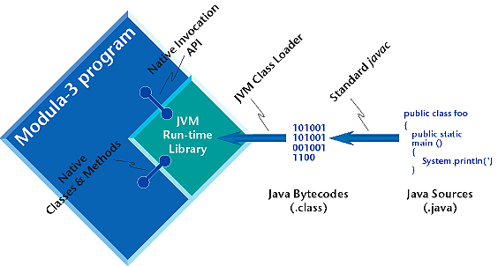
JVM and Java “bytecode”
Java program is not compiled into native machine language but “bytecode”
Each OS has its own implementation of JVM
The bytecode talks to the JVM, and the JVM talks to the OS

Slide 19
So, What is JVM?
Software "execution engine" that safely and compatibly executes the byte codes in Java class files on a microprocessor

Slide 20
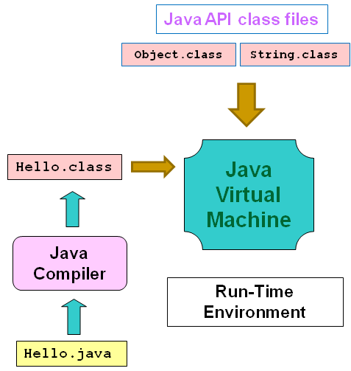
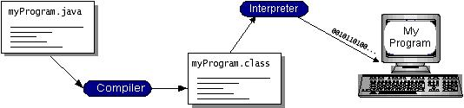
How JVM work?
Program is compiled into bytecode once
The JVM interprets the bytecode into native machine code

Slide 21
That’s why Bill Gates isn’t in love with Java!
Java Source
Java bytecode
JVM-Win
JVM-Mac
JVM-Unix
JVM-IBM
Windows
MAC
UNIX
MVS

Slide 22
How to run Java Program?
JVM is part of the Sun Java 2 Runtime Environment, Standard Edition (JRE)
The JVM is not a standalone program
To run Java application, your OS have to install JRE

Slide 23
Java Runtime Environment (JRE)
A subset of the Java Development Kit (JDK) for end-users and developers who want to redistribute the runtime environment alone.
The JRE consists of the JVM, the Java core classes, and supporting files
Where to download JRE?
Access Oracle website
Google it

Slide 24

How to build Java programs?

Slide 25
To create Java program
Use simple text editor (notepad,…) for source codes
Save source code file with extension ‘java’
HelloWord.java

Slide 26
How about compile, test or debug Java programs?
Use Java programming environment and tools
Depends on the type of Java application will have corresponding Java programming environment

Slide 27
Java Programming Environment
J2SE (Java 2 Platform, Standard Edition (JDK) )
A software development package from Sun Microsystems
Provide the basic set of tools needed to write, test and debug Java applications and applets.
Version currently JDK 17 (2021)
J2EE (Java 2 Platform, Enterprise Edition)
for enterprise servers and applications
J2ME (Java 2 Platform, Micro Edition)
for consumer and embedded servers and applications

Slide 28
Here we are now, J2SE
The edition of the Java platform that enables development, deployment, and management of cross-platform, general-purpose applications.

Slide 29
Tools under J2SE (JDK)
javac:
Compiler used to compile Java source code
java:
Interpreter used to execute Java byte codes
appletviewer:
Used to view and test applets
javadoc:
The Java documentation tool, generates detailed documentation in HTML form for any .java source code or package

Slide 30



Visual Development Tools
Java Studio Enterprise.
Sun Java Studio Creator.
Borland JBuilder
NetBeans.
JDeverloper.
Eclipse
Jet brain Intelli J

Slide 31
Programming with Java, what exactly do you have to learn?
Learn Java program language.
Learn Java Class Libraries (Java APIs).
That’s it!

Slide 32
Learn Java as Programming Language
Java has a syntax and rules similar to C#.
Every thing you learn in C# is also useful in Java.
VERY IMPOTANT:
Java is Object-Oriented Programming language (OOP)
Everything in the Java language behaves like an object.
Never forget, please!

Slide 33
Java Programming Language features
Object-oriented
Platform-independent
Robust
All data to be declared explicitly
Check the code at the time of compilation and interpretation
Eliminates the programming errors
Secure
Secure environment for executing programs
Several layers of security control
Distributed
Portable across multiple platform, OS, GUI.
Support network application
Multi-thread
Perform many tasks simultaneously

Slide 34
Learn Java Class Libraries (Java APIs)
Java has a rich collection of Class Libraries.
Java APIs (Application Programming Interface)
These class libraries greatly simplify your job as a Java programmer.
They help you to write complex programs quickly.
To master Java, you must master these class libraries.

Slide 35
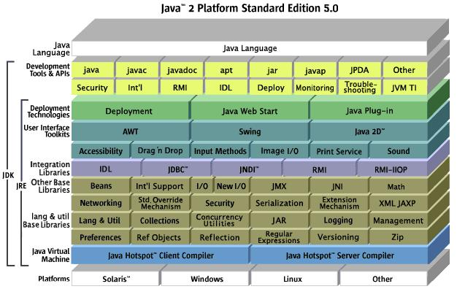
Java class library (J2SE)

Slide 36
That’s it!
Programming with Java, all you have to learn is:
Learn Java program language.
Learn Java Class Libraries (Java APIs)
OOP

Slide 37
#3 – Setup java development environment
Setup java development environment
Your first simple Java program

Slide 38
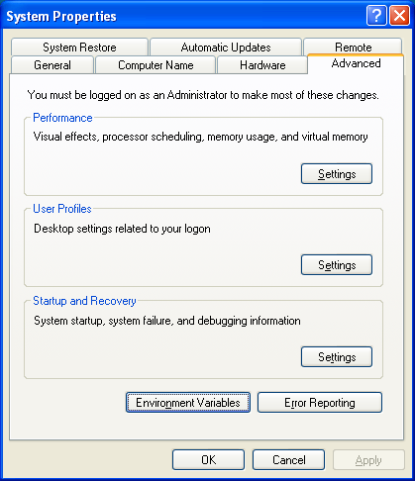
Setup java development environment
Download and install JDK
(or the bundle jdk and Netbeans)
Setup environment variables
Create JAVA_HOME:
C:\Program Files\Java\jdk-15.0.1
Modify Path
%JAVA_HOME%\bin;

Slide 39
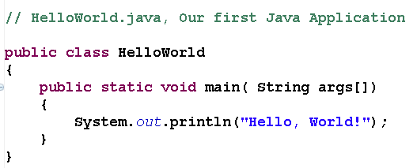
A Simple Java Program
Use simple text editor (notepad) to write source codes
Source code File must:
Has file name of “public class ….”
Has “java” extension

Slide 40
Compile Java Program
Start “command prompt” program
Use JDK tool: javac
C:\> javac HelloWorld.java

Slide 41
Execute Java Program
Use JDK tool: java
C:\>java HelloWorld
Hello World!

Slide 42
Java Identifiers
The identifier is the name used for classes, variables, and methods.
All identifiers should begin with a letter (A to Z or a to z), currency character ($) or an underscore (_)
After the first character, identifiers can have any combination of characters
A keyword cannot be used as an identifier.
Most importantly, identifiers are case sensitive.
Examples of legal identifiers: age, $salary, _value, __1_values.
Examples of illegal identifiers: 123abc, -salary.

Slide 43
Comments in Java
Java supports both single-line and multiple-line comments, and they are similar to C and C++.
// This is single-line comment public class MyFirstProgram
{
public static void main(String[] args)
{
System.out.println("Hello World!");
/*
This is multiple-line comment
*/
}
}

Slide 44
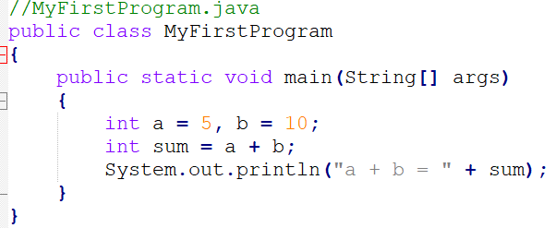
Data Types
Primitive data types
Type | Default | Size
boolean | false | 1 bit
byte | 0 | 8 bits
char | \u0000 | 16 bits
short | 0 | 16 bits
int | 0 | 32 bits
long | 0 | 64 bits
float | 0.0 | 32 bits
double | 0.0 | 64 bits
Notes:
Primitive: nguyên thuỷ

Slide 45
Basic Operators
Java provides a rich set of operators to manipulate variables, including:
Arithmetic operators
Relational operators
Bitwise operators
Logical operators
Assignments operators
Notes:
Primitive: nguyên thuỷ

Slide 46
Basic Operators
Arithmetic operators :
Initial two variables a = 20 and b = 10.
Operators | Example
+ (addition) | a + b will give 30
- (subtraction) | a – b will give 10
* (multiplication) | a * b will give 200
/ (division) | a / b will give 2
% (modulus) | a % b will give 0
++ (increment) | b++ will give 21
-- (decrement) | b-- will give 19
Notes:
Primitive: nguyên thuỷ

Slide 47
Basic Operators
Relational operators :
Initial two variables a = 20 and b = 10.
Operators | Example
== (equal to) | (a == b) is false
!= (not equal to) | (a != b) is true
> (greater than) | (a > b) is false
< (less than) | (a < b) is true
>= (greater than or equal to) | (a >= b) is false
<= (less than or equal to) | (a <= b) is true
Notes:
Primitive: nguyên thuỷ

Slide 48
Basic Operators
Logical operators :
Initial two variables a = true and b = false.
Operators | Example
&& (logical and) | (A && B) is false
|| (logical or) | (A || B) is true
! (logical not) | !(A && B) is true
Notes:
Primitive: nguyên thuỷ

Slide 49
Basic Operators
Assignment operators :
Operators | Example
= | C = A + B will assign value of A + B into C
+= | C += A is equivalent to C = C + A
-= | C -= A is equivalent to C = C - A
*= | C *= A is equivalent to C = C * A
/= | C /= A is equivalent to C = C / A
%= | C %= A is equivalent to C = C % A
Notes:
Primitive: nguyên thuỷ

Slide 50
Text Output
print(): This method in Java is used to display a text on the console. This text is passed as the parameter to this method in the form of String. This method prints the text on the console and the cursor remains at the end of the text at the console. The next printing takes place from just here.
Example:
class Demo {
public static void main(String[] args)
{
System.out.print("Hello! ");
System.out.print("Hello! ");
System.out.print("Hello! ");
}
}
Output: Hello! Hello! Hello!
Notes:
Primitive: nguyên thuỷ

Slide 51
Text Output
println(): This method in Java is also used to display a text on the console. It prints the text on the console and the cursor moves to the start of the next line at the console. The next printing takes place from the next line.
Example:
class Demo {
public static void main(String[] args)
{
System.out.println("Hello! ");
System.out.println("Hello! ");
System.out.println("Hello! ");
} }
Output:
Hello!
Hello!
Hello!
Notes:
Primitive: nguyên thuỷ

Slide 52
Text Output
printf(): This is the easiest of all methods as this is similar to printf in C. Note that System.out.print() and System.out.println() take a single argument, but printf() may take multiple arguments. This is used to format the output in Java.
Example:
class Demo {
public static void main(String args[])
{
int x = 100;
System.out.printf("Printing simple" + " integer: x = %d\n",x);
System.out.printf("Formatted with" + " precision: PI = %.2f, x = %d\n", Math.PI, x);
float n = 5.2f;
System.out.printf("Formatted to " + "specific width: n = %.4f\n", n);
n = 2324435.3f;
System.out.printf("Formatted to " + "right margin: n = %20.4f\n", n);
}
}
Output:
Printing simple integer: x = 100
Formatted with precision: PI = 3.14, x = 100
Formatted to specific width: n = 5.2000
Formatted to right margin: n = 2324435.2500
Notes:
Primitive: nguyên thuỷ

Slide 53
Text Input from Keyboard
Java provides a Scanner class, it is used to get user input, and it is found in the java.util package
Method | Description
nextBoolean() | Reads a boolean value from user
nextByte() | Reads a byte value from the user
nextDouble() | Reads a double value from the user
nextFloat() | Reads a float value from the user
nextInt() | Reads a int value from the user
nextLine() | Read a String value from the user
nextLong() | Reads a long value from the user
nextShort() | Reads a short value from the user
Notes:
Primitive: nguyên thuỷ

Slide 54
Text Input from Keyboard
Example:
import java.util.Scanner;
class MyFirstProgram
{
public static void main(String[] args)
{
Scanner sc = new Scanner(System.in);
String name = sc.nextLine();
int age = sc.nextInt();
System.out.println("Name: " + name);
System.out.println("Age: " + age);
}
}
Notes:
Primitive: nguyên thuỷ

Slide 55
Java Methods
Create a Method: A method must be declared within a class. It is defined with the name of the method, followed by parentheses ().
modifier static returnType nameOfMethod (parameter1, parameter2, ...) {
// method body
}
modifier - It defines access types whether the method is public, private, protected…
static - If we use the static keyword, it can be accessed without creating objects.
parameter1/parameter2 - These are values passed to a method. We can pass any number of arguments to a method.
returnType - It specifies what type of value a method returns For example if a method has an int return type then it returns an integer value.
methodName - It is an identifier that is used to refer to the particular method in a program
Calling a Method:
myMethod();
Notes:
Primitive: nguyên thuỷ

Slide 56
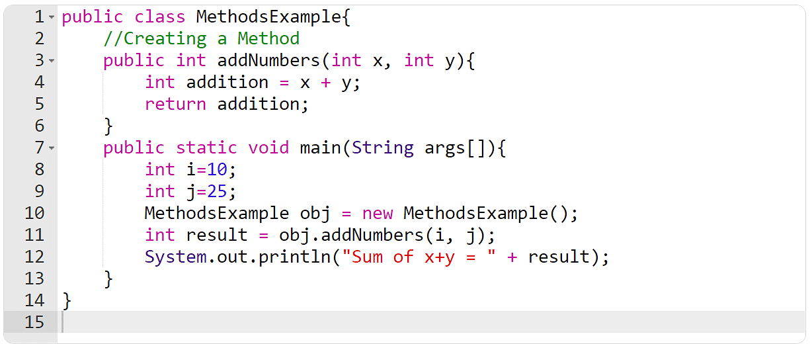
Java Methods
Example:
Notes:
Primitive: nguyên thuỷ

Slide 57
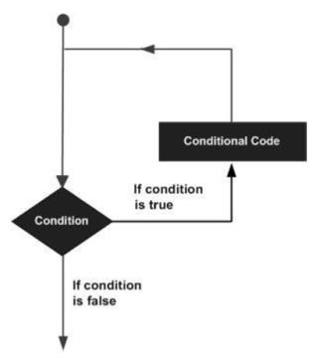
Loop Control
Java programming language provides the following types of loop to handle looping requirements:
while loop
for loop
do ... while loop
Notes:
Primitive: nguyên thuỷ

Slide 58
Loop Control
while loop
A while loop statement in Java programming language repeatedly executes the target statement as long as a given condition is true.
Example
public class MyFirstProgram
{
public static void main(String[] args)
{
int i = 1, sum = 0; while (i <= 0)
{
sum = sum + i;
i++;
}
System.out.println("sum = " + sum);
}
}
Notes:
Primitive: nguyên thuỷ

Slide 59
Loop Control
for loop
A for loop is a repetition control structure that allows you to efficiently write a loop that needs to be executed a specific number of times. A for loop is useful when you know how many times a task will be repeated.
Example
public class MyFirstProgram
{
public static void main(String[] args)
{
int sum = 0;
for (int i = 1; i <= 10; i++)
{
sum += i;
}
System.out.println("sum = " + sum);
}
}
Notes:
Primitive: nguyên thuỷ

Slide 60
Loop Control
for each loop
which is used exclusively to loop through elements in an array
Example
String[] cars = {"Volvo", "BMW", "Ford", "Mazda"};
for (String i : cars) {
System.out.println(i);
}
Notes:
Primitive: nguyên thuỷ

Slide 61
Loop Control
do... while loop
A do ... while loop is similar to a while loop, except that, do ... while loop is guaranteed to execute at least one time
Example:
public class MyFirstProgram
{
public static void main(String[] args)
{
int i = 0, sum = 0; do {
sum = sum + i; i++;
} while (i <= 10)
System.out.println("sum = " + sum);
}
}
Notes:
Primitive: nguyên thuỷ

Slide 62
Loop Control
Break and Continue
The break statement can also be used to jump out of a loop.
Example:
for (int i = 0; i < 10; i++) {
if (i == 4) {
break;
}
System.out.println(i);
}
The continue statement breaks one iteration (in the loop), if a specified condition occurs, and continues with the next iteration in the loop.
Example
for (int i = 0; i < 10; i++) {
if (i == 4) {
continue;
}
System.out.println(i);
}
Notes:
Primitive: nguyên thuỷ

Slide 63
Conditional Statements
Decision making structures have one or more conditions to be evaluated or tested by the program, along with a statement or statements that are to be executed if the condition is determined to be true, and optionally, other statements to be executed if the condition is determined to be false.
Java provides two main types of conditional statements:
if ... else statement (*)
switch ... case statement (*)
? ...: ... :
Notes:
Primitive: nguyên thuỷ

Slide 64
Conditional Statements
Example:
public class MyFirstProgram
{
public static void main(String[] args)
{
int x = 11, y = 12; if (x < y && x + y >= 0)
{
System.out.println("True");
}
else
{
System.out.println("False");
}
}
}
Notes:
Primitive: nguyên thuỷ

Slide 65
Conditional Statements
Example:
public class MyFirstProgram
{
public static int findMax(int a, int b)
{
return (a > b)? a: b;
}
public static void main(String[] args)
{
int x = 5, y = 6;
System.out.println("Max is " + findMax(x, y));
}
}
Notes:
Primitive: nguyên thuỷ

Slide 66

Exercises
Write a program input and print your name, date of birth, and student ID.
Write a function to convert the temperature from Fahrenheit to Celsius and a function to convert the temperature from Celsius to Fahrenheit.
3. Write a function to count number of digits in a number.
Notes:
Primitive: nguyên thuỷ

Slide 67
Arrays, ArrayList and String

Slide 68
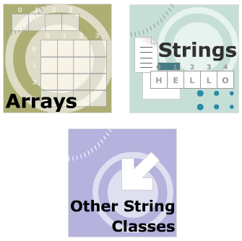
Module Objective
Arrays
Define an array.
Explain single - dimension array
Describe two – dimension array
String
Other String class

Slide 69
#1 - Array
Introduction to Arrays
Array declaration
Initializing Array Elements
Accessing Array Elements

Slide 70

Why do we need an array?

Slide 71

Introduction to Arrays
Special data store that can hold several items of a single data type in contiguous memory location.
All the elements within an array must belong to the same data type.
Arrays are zero indexed
An array with n elements is indexed from 0 to n-1.
Array in Java is Object

Slide 72
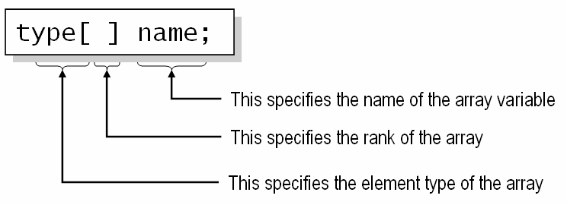
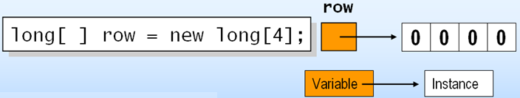
Array declaration
Declaring an array variable does not create an array!
You must use new to explicitly create the array instance
The default value of numeric array elements are set to zero, and reference elements are set to null.

Slide 73
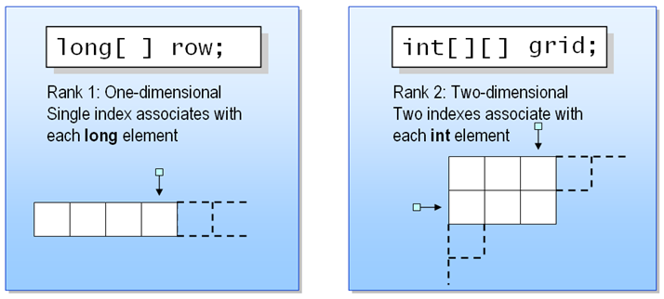
Array dimension
The number of indexes associated with each element

Slide 74
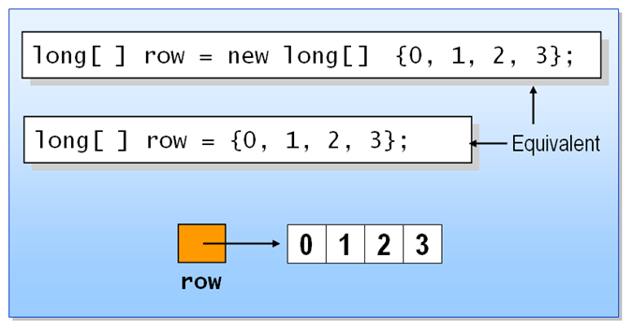
Initializing Array Elements
The elements of an array can be explicitly initialized
You can use a convenient shorthand

Slide 75
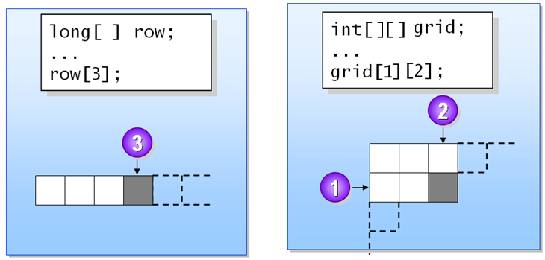
Accessing Array Elements
Supply an integer index for each dimension
Indexes are zero-based

Slide 76
Types of Arrays
Single - Dimensional Arrays
Multi - Dimensional Arrays (matrix, arrays of arrays)

Slide 77
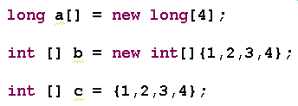
Single-Dimensional Arrays
Have only one dimension and is visually represented as having several row but a single column of data.

Slide 78

Working with Single-Dimensional Arrays
Store elements :
Initialize individual array elements
Use Loop to initialize
Access elements:
Using Loop
“for..each” loop (JDK 1.5)

Slide 79
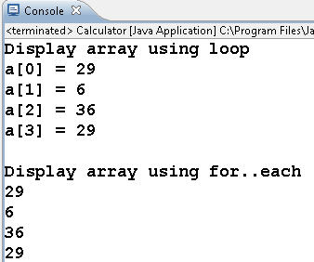
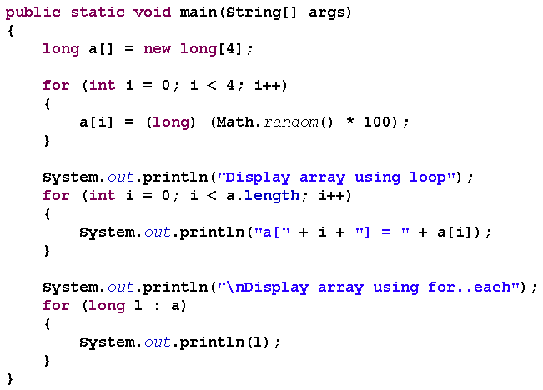
Example of Working with Single-Dimensional Arrays

Slide 80

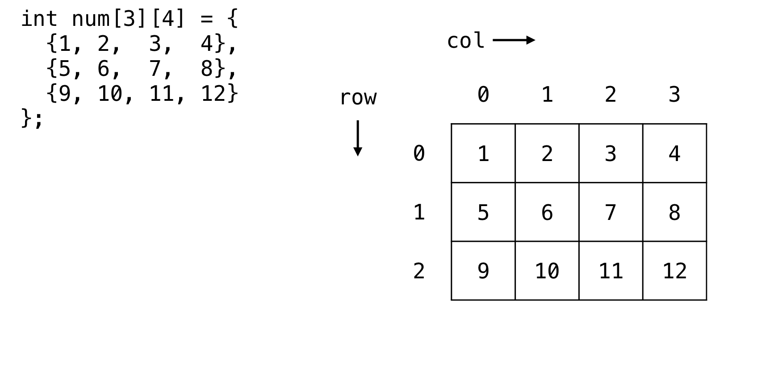
Multidimensional Arrays, (matrix, arrays of arrays)
<data type> [ ] [ ] <array name> = new <data type> [ rows][cols]
int num[3][4] = new int [3][4]

Slide 81
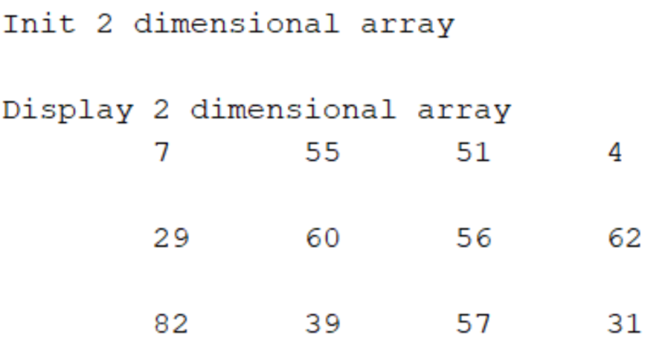
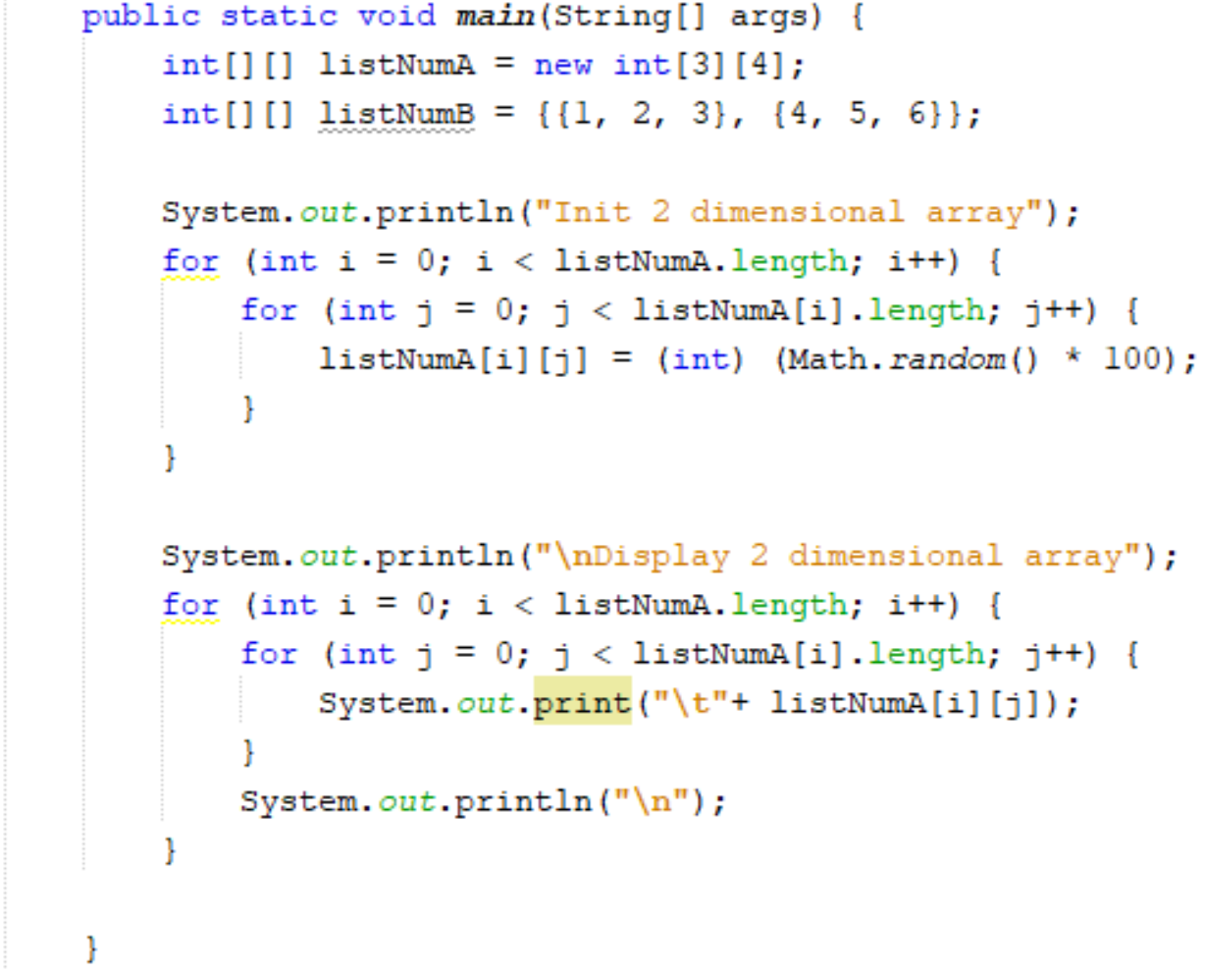
Working with Multidimensional Arrays

Slide 82
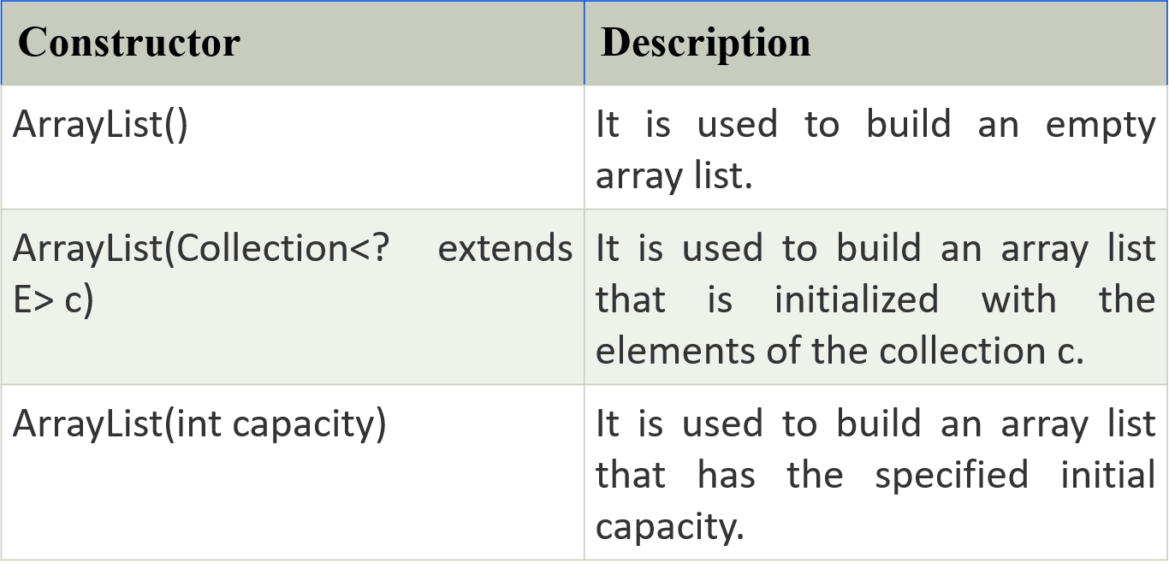
#2 – ArrayList
Java ArrayList class uses a dynamic array for storing the elements. It is like an array, but there is no size limit. We can add or remove elements anytime. So, it is much more flexible than the traditional array. It is found in the java.util package. It is like the Vector in C++.
Constructors of ArrayList

Slide 83
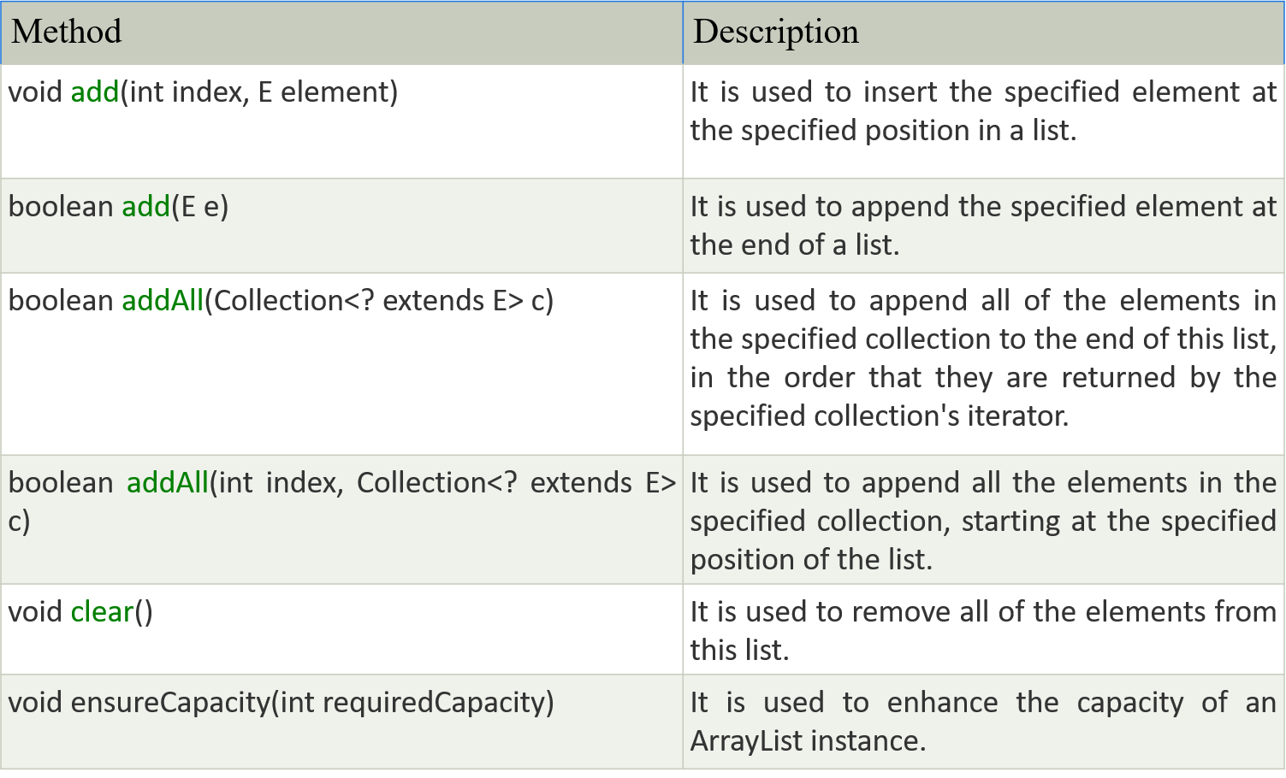
#2 – ArrayList
Methods of ArrayList

Slide 84
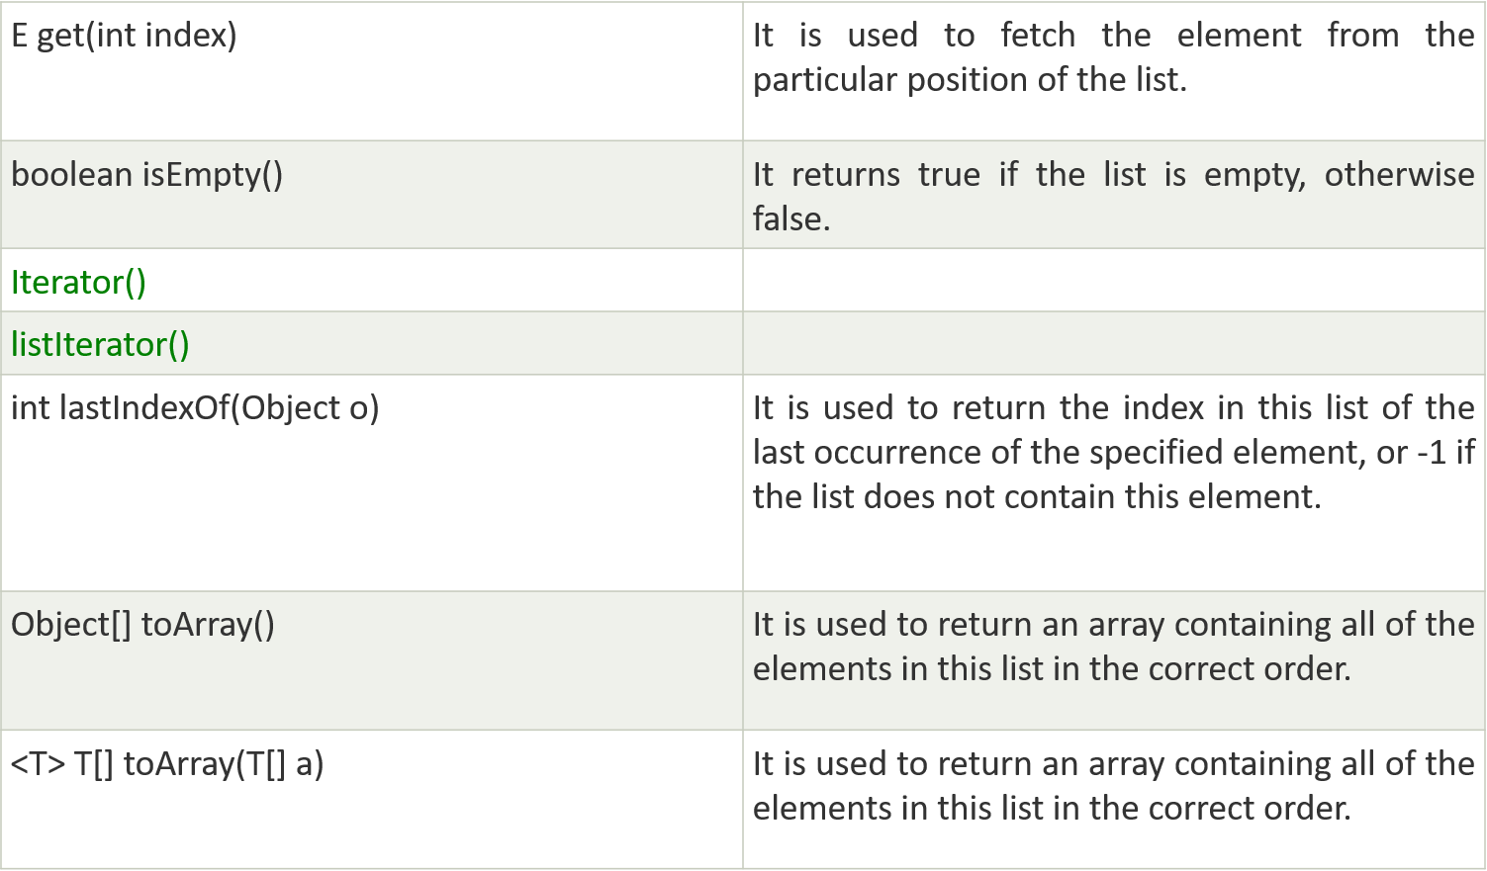
#2 – ArrayList
Methods of ArrayList (conts)

Slide 85
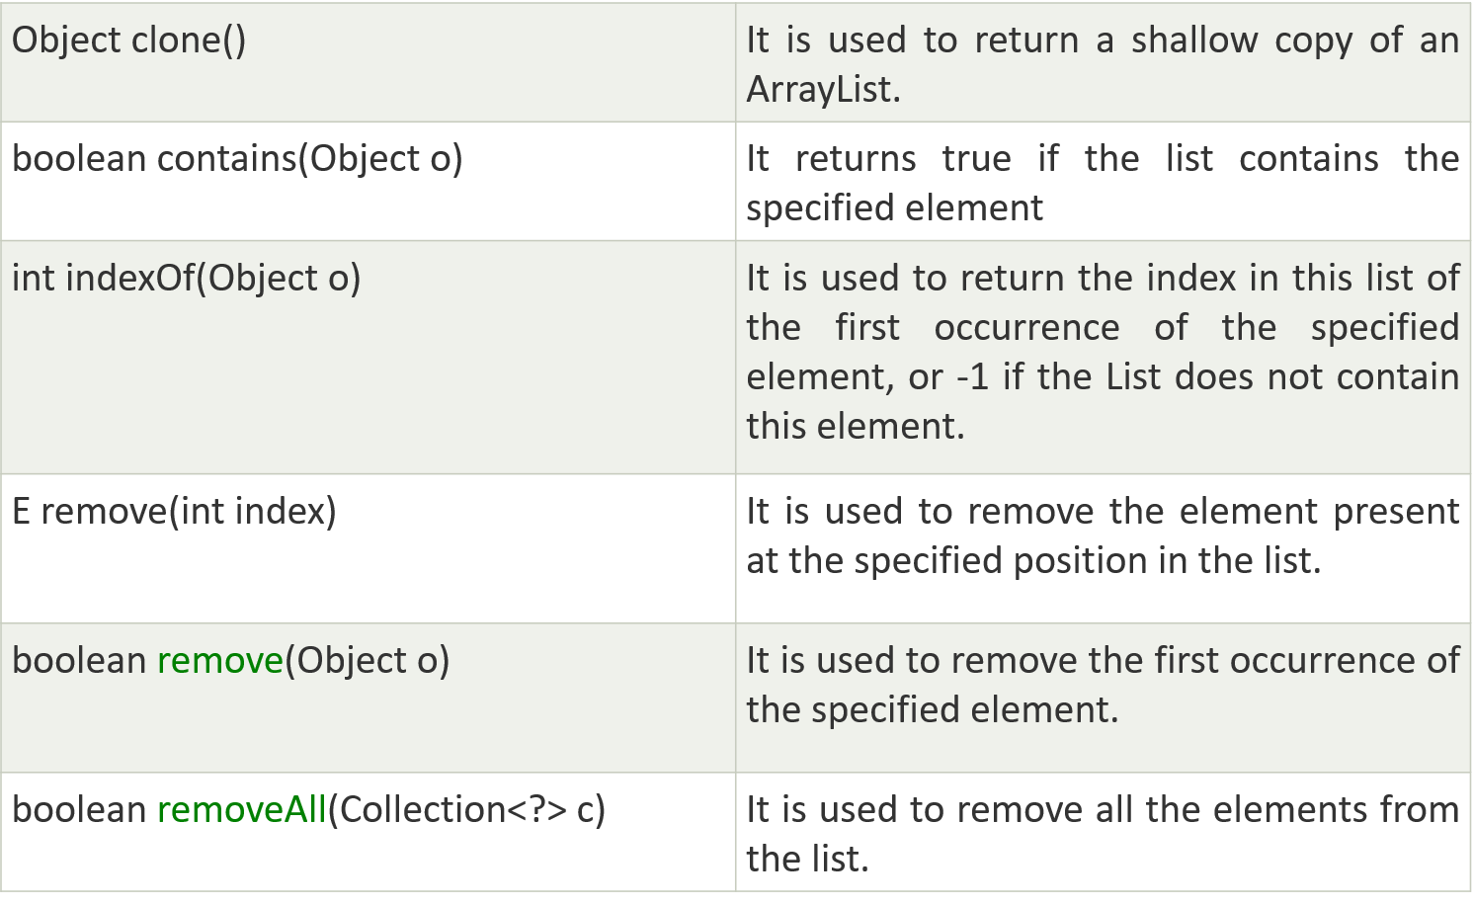
#2 – ArrayList
Methods of ArrayList (conts)

Slide 86
#2 – ArrayList
Example
import java.util.*;
public class ArrayListExample1{
public static void main(String args[]){
ArrayList<String> list=new ArrayList<String>();//Creating arraylist
list.add("Mango");//Adding object in arraylist
list.add("Apple");
list.add("Banana");
list.add("Grapes");
//Printing the arraylist object
System.out.println(list);
}
}

Slide 87
#2 – ArrayList
Example: using For-each loop
import java.util.*;
public class ArrayListExample3{
public static void main(String args[]){
ArrayList<String> list=new ArrayList<String>();
list.add("Mango");
list.add("Apple");
list.add("Banana");
list.add("Grapes");
for(String fruit:list)
System.out.println(fruit);
}
}

Slide 88
#3 - String class
Describe String
Methods of String class
Describe String array and its use
Describe command line arguments in Java and its use

Slide 89
String class
The String class represents character strings.
String str=“AbcD EfGh123@”;
Strings are constant
Values cannot be changed after they are created.
String str=“ABC”;
str=“efd”; //it creates another new string “efd” in memory.
String objects are immutable (unmodifiable or unchangeable)
they can be shared across different threads.

Slide 90
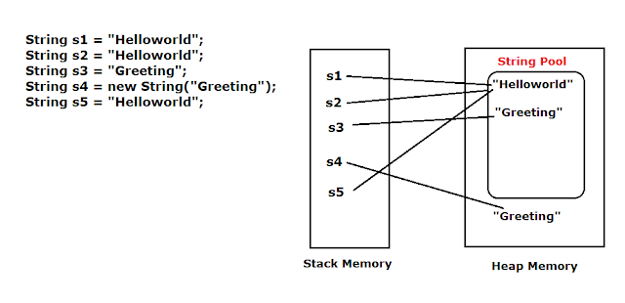
String class

Slide 91
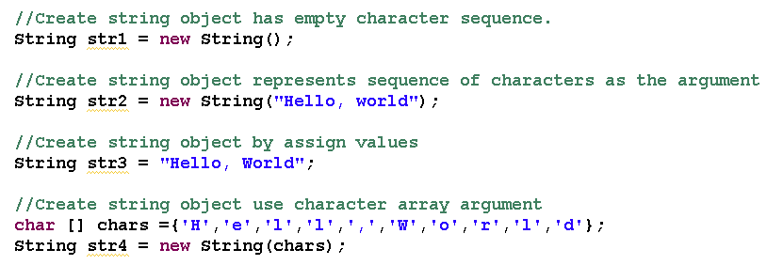
Create a String Object

Slide 92
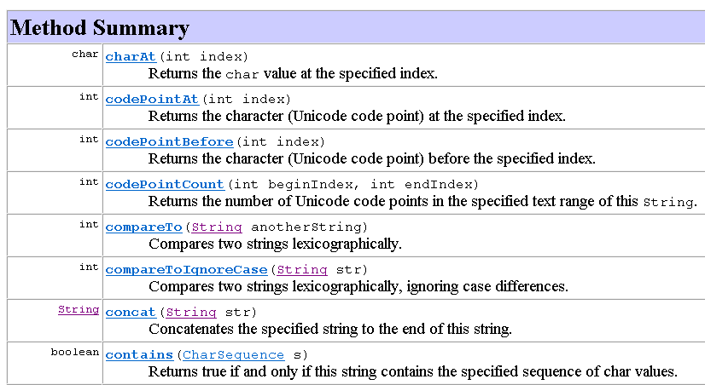
Methods of String class

Slide 93
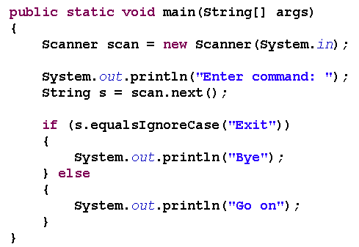
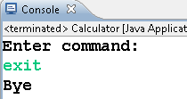
Example of Using String class

Slide 94
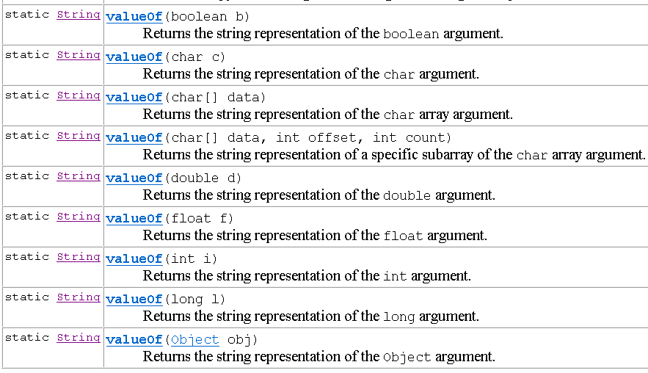
To convert other data type to String object

Slide 95
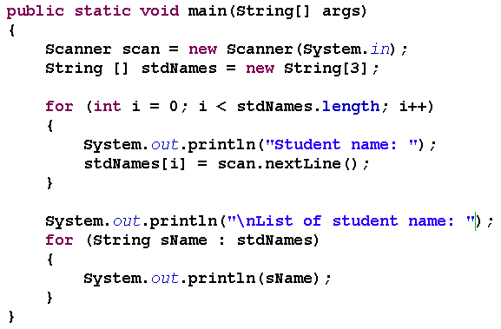
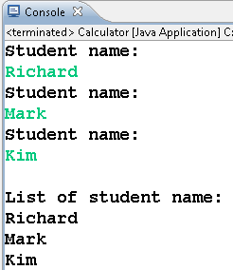
String Arrays

Slide 96
Exercises
Write a function to count how many prime number in an array. (ArrayList)
Write a Java program that receive the full name of a person and write functions to:
Return the first name and last name, except the middle name. (Ex: Nguyen Van Chien → Nguyen Chien)
Return the middle name. (Ex: Nguyen Thi Thu Thao → Thi Thu)
Capitalize the full name. (Ex: nguyen van chien → Nguyen Van Chien)
Uppercase all vowels and lowercase all consonants. (Ex: Nguyen Van Chien → ngUyEn vAn chIEn)
Notes:
Primitive: nguyên thuỷ

Slide 97
References
E-Book
Java Programming, 8th Edition Joyce Farrel
JDK Document 1.8
Java Tutorial
Java Tutorial Example
Website
http://www.oracle.com/technetwork/articles/javase/jdk-netbeans-jsp-142931.html

Slide 98
That’s about all for today!
Java architecture
Java “bytecode”
JVM
J2SE, JRE & JDK
Java is Object-Oriented Programming language.
What exactly do you learn in Java and how to learn Java?
Thank you all for your attention and patient !

Slide 99
WAIT A MINUTE!!
WHAT WILL WE USE TO PRACTICE IN THIS COUSE
JDK: 17
IDE: APACHE NETBEAN 17
→ Software folder in Moodle

